Slide 1
LTAR Cropland Design Meeting
Minneapolis Nov 18-20, 2015
Objective of meeting
Define the minimum design criteria for the Common Experiment at cropland sites
Other issues
…….

Slide 2
LTAR Cropland Design Meeting
Minneapolis Nov 18-20, 2015
Guiding Principles for the Common Experiment Design
The Common Experiment is not the only experiment
We seek the simplest possible core design for the Common Experiment in order to maximize participation, longevity, and comparability
It can supplemented locally as you like, later
The minimum core design consists of 2 fully instrumented field-scale treatments at one geographic location per LTAR site (BAU, ASP)
It hasn’t started yet.

Slide 3
Minimum Design Criteria for the LTAR Common Experiment
2 treatments (BAU, ASP)
Field Scale
___ replicates (n)
__ minimum field size (ha)
Plot Scale
___ replicates (n)
___ minimum plot size (ha)
Starting dates
___ overall start date(s)
___ treatment date(s)

Slide 4
Statistical Design Considerations
REQUIRED
True replication at both field and plot scales
Baseline sampling – both spatial and temporal
Carefully planned blocking
Relatively consistent plot sizes
DESIRED
At least 2 field replicates per treatment
At least 4 plot replicates per treatment (increase power)
Large plot sizes (>50 x 50m)
Staggered start dates
All rotation phases present

Slide 5
Field Scale Experiment
Field Size
Preferred size is 16 ha – strong consensus
Minimum size is 10 ha – strong consensus
Number of replicate fields per treatment
Preferred number is 4-6 – strong consensus
Minimum number is 1.5 – moderate consensus
(1.5 means one of the two treatments is replicated; n=1 removes local but not national inference ability; 2 is better than 1.5)

Slide 6
Plot Scale Experiment
Plot Size
Preferred size is 1 ha – moderate consensus
Minimum size is 0.1 ha – strong re-consensus
Number of replicate plots per treatment
Preferred number is 4-6 – strong consensus
Minimum number is 3 – strong consensus

Slide 7
Starting Dates
Number of treatment start dates
Preferred no. of start dates is >1 – moderate consensus
Minimum number is 1 – strong consensus
Treatment start date
Preferred start date is after a 1 year baseline period with same crop across all experimental units
Minimum start date is after a 1 growing season baseline period with same crop across all experimental units

Slide 8
BAU Parameters
Define: Prevailing practices on a predominant cropping system in an LTAR site’s area
Source of information
Preferred: formal survey of area producers (annualized)
Minimum: Local experts (Crop consultants, extension educators, NASS & satellite databases, farmers)
Types of information
Preferred: for predominant cropping system tillage, rotation, fertility, pest management, irrigation management, equipment, inputs
Minimum: same as preferred
How often reviewed and potentially changed
Preferred: every 3-5 yr based on rolling average of survey results (site-specific)

Slide 9
ASP Parameters
Define: site-prioritized ecosystem services
Who informs?
Primary: Researchers, innovative farmers
Secondary: stakeholders, federal policy, climate trends and models
What tools (how do you get the information?)
Primary: Exploratory experiments (action/adaptation)
Secondary: Meta-analysis & modeling; analysis of emerging technologies
How often reviewed and potentially changed
Five years, based on rolling 5 yr average informed by BAU adoption, new technology and agronomic innovations, and socioeconomic change (e.g. markets)

Slide 10
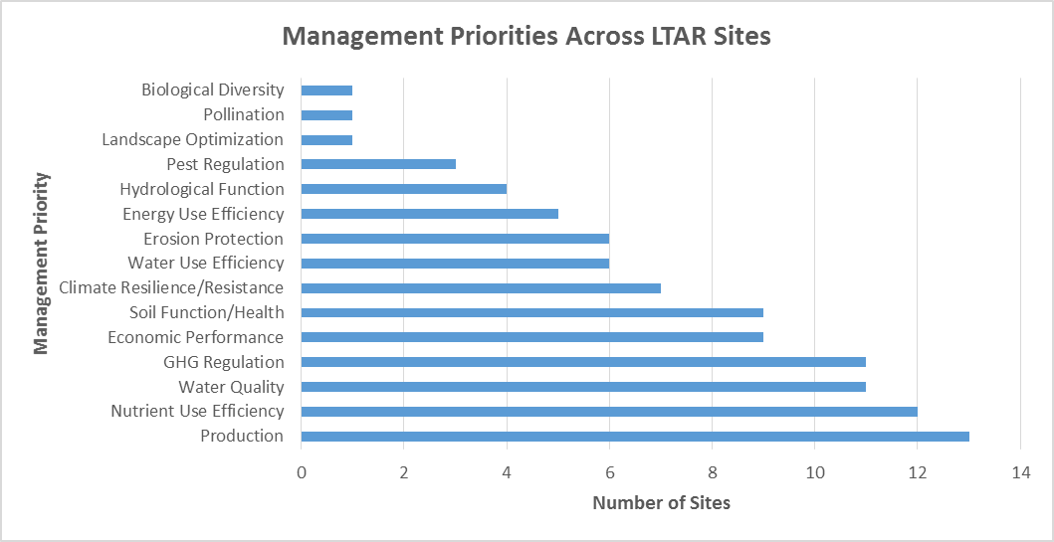
ASP Management Priorities
Strong consensus – Production, Nutrient use efficiency
Moderate consensus – Water quality, GHG regulation, Economic performance, Soil function/health

Slide 11

LTAR Cropland Design Meeting
Minneapolis Nov 19, 2016
Objective of meeting
Define the minimum design criteria for the Common Experiment at cropland sites
Other issues
…..

Slide 12
Next Steps
Sites should finalize their field designs based on minimum and preferred design criteria as designated here.
Individual site designs should be vetted by our statisticians Sara Duke and Sasha Kravchenko, who are available for consultation.
Final proposed designs should be reported at the February 2016 meeting.
All sites should be ready to plant their baseline year crop in Spring 2016, pending available funding, and to initiate baseline sampling activities.
In preparation for deployment of BAU and ASP treatments in Fall 2016, funded sites need to define BAU and ASP and finalize management priorities as per information and protocols above.
Baseline sampling protocols need development.
Experimental sampling protocols need to be finalized.

